Slide 1
What is feature engineering
Feature engineering is the pre-processing step of machine learning, which extracts features from raw data. It helps to represent an underlying problem to predictive models in a better way, which as a result, improve the accuracy of the model for unseen data. The predictive model contains predictor variables and an outcome variable, and while the feature engineering process selects the most useful predictor variables for the model.

Slide 2
What is an imputation technique
Feature engineering deals with inappropriate data, missing values, human interruption, general errors, insufficient data sources, etc. Missing values within the dataset highly affect the performance of the algorithm, and to deal with them "Imputation" technique is used. Imputation is responsible for handling irregularities within the dataset.
For example, removing the missing values from the complete row or complete column by a huge percentage of missing values. But at the same time, to maintain the data size, it is required to impute the missing data, which can be done as:
For numerical data imputation, a default value can be imputed in a column, and missing values can be filled with means or medians of the columns.
For categorical data imputation, missing values can be interchanged with the maximum occurred value in a column.

Slide 3
What is a feature encoding
In many practical data science activities, the data set will contain categorical variables. These variables are typically stored as text values”. Since machine learning is based on mathematical equations, it would cause a problem when we keep categorical variables as is. Many algorithms support categorical values without further manipulation, but in those cases, it’s still a topic of discussion on whether to encode the variables or not. The algorithms that do not support categorical values, in that case, are left with encoding methodologies

Slide 4
What are the different types of encoding techniques
One Hot Encoding: — In this method, we map each category to a vector that contains 1 and 0 denoting the presence of the feature or not. The number of vectors depends on the categories which we want to keep. For high cardinality features, this method produces a lot of columns that slows down the learning significantly. There is a buzz between one hot encoding and dummy encoding and when to use one. They are much alike except one hot encoding produces the number of columns equal to the number of categories and dummy producing is one less. This should ultimately be handled by the modeler accordingly in the validation process.

Slide 5
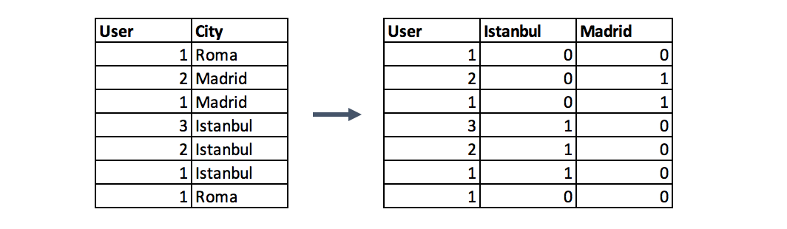

Slide 6
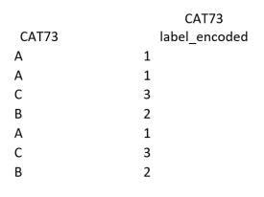
Label Encoding: — In this encoding each category is assigned a value from 1 through N (here N is the number of category for the feature). It may look like (Car<Bus<Truck ….0 < 1 < 2). Categories that have some ties or are close to each other lose some information after encoding.

